Slide 1
Estrogen as an immunomodulator and its role in multiple sclerosis prevention: a systematic review
Kuang-Ying (Bruce) Chen
Praneet Gandhoke, Nachiket Nijampurkar, Hala Nasar
Alberto Dominguez-Bali, MD

Slide 2
Research Question
How does estrogen modulate immune function, and what is its role in preventing multiple sclerosis in at-risk populations?
Population: Perimenopause (35-65) women with multiple sclerosis or at risk.
Intervention: Estrogen or estrogen-based therapies.
Comparison: Non-estrogen therapies or placebo.
Outcome: Immunomodulation, autoimmune disease incidence/prevention.

Slide 3
Protocol
Inclusion Criteria:
Studies on humans relevant to estrogen's effects on immune function.
Peer-reviewed journals.
Specific autoimmune disease: multiple sclerosis
Timeframe: last 10 years
Exclusion Criteria:
Non-English studies
Irrelevant topics:
non-immune functions of estrogen,
No mention of estrogen
Studies on animal models
Register the protocol with PROSPERO.

Slide 4
Comprehensive Literature Search
PubMed: ("Estrogens"[MeSH] OR Estrogen) AND (MS OR “multiple sclerosis”) AND ("Hormone Replacement Therapy"[MeSH] OR “Estrogen Replacement Therapy"[MeSH] OR Prevention)
Filters applied: in the last 10 years.
349 results: pubmed-EstrogensM-set (PubMed) (2).nbib

Slide 5
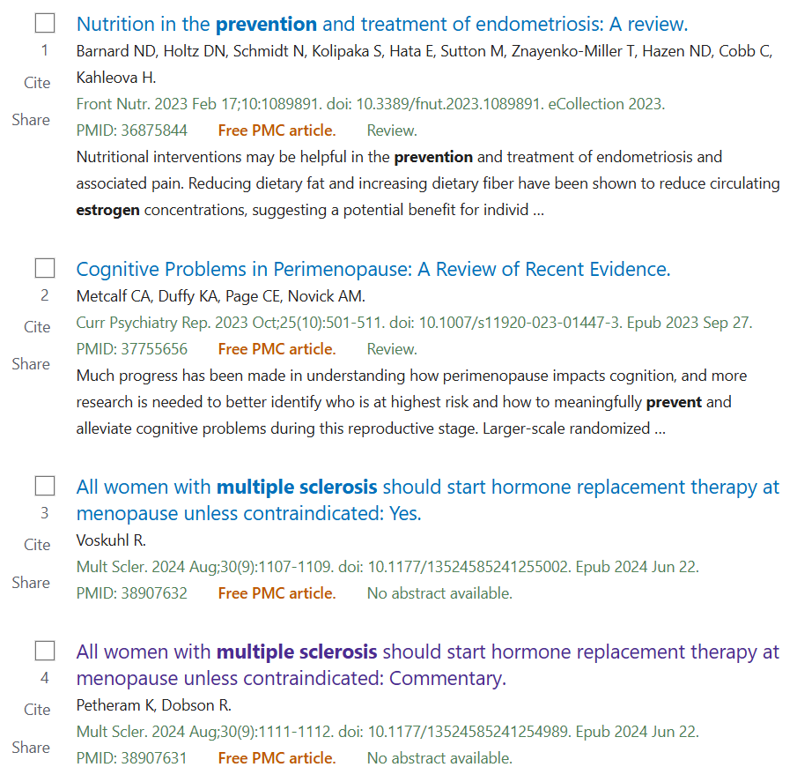
PubMed

Slide 6
Comprehensive Literature Search
Embase: ('estrogens'/exp OR 'estrogens' OR 'estrogen'/exp OR 'estrogen') AND ('multiple sclerosis' OR 'ms') AND ('hormone therapy'/exp OR 'hormone therapy' OR 'prevention'/exp OR 'prevention') AND [2015-2025]/py
? results: records(Embase).ris

Slide 7
Embase
?

Slide 8
Comprehensive Literature Search
Cochrane Library: (Estrogens OR Estrogen) AND (MS OR “multiple sclerosis”) AND ("Hormone Therapy" OR Prevention)
with Cochrane Library publication date from Jan 2015 to present, (Word variations have been searched)
1 Cochrane Reviews: citation-export (Cochrane Review) (2).ris
41 Trials: citation-exports (CochraneTrials).ris
0 results matching 'Intervention "Estrogens" AND Outcome ("Multiple Sclerosis")'

Slide 9
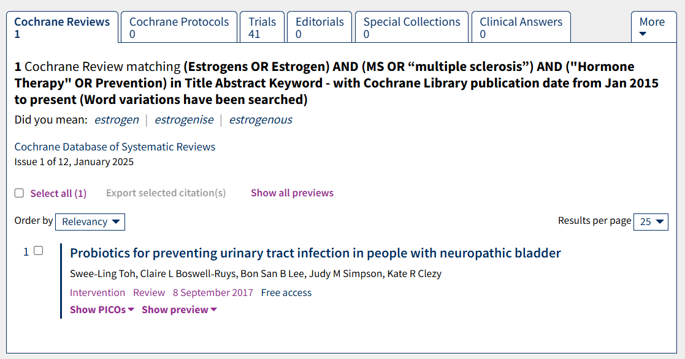
Cochrane Reviews
?

Slide 10
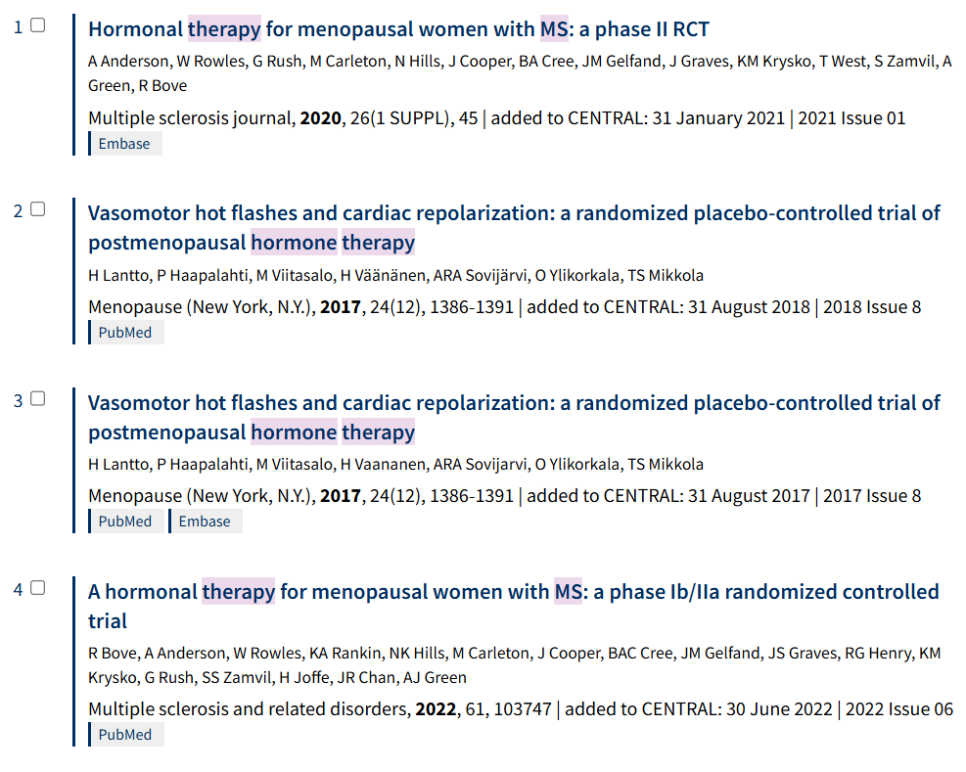
Trials

Slide 11
Comprehensive Literature Search
Web of Science: TS=(Estrogens OR Estrogen) AND TS=(MS OR “multiple sclerosis”) AND TS=("Hormone Therapy" OR Prevention)
| Timespan: 2015-01-01 to 2024-12-31 (Publication Date)
164 Documents: savedrecs (Web of Science) (2).ris

Slide 12
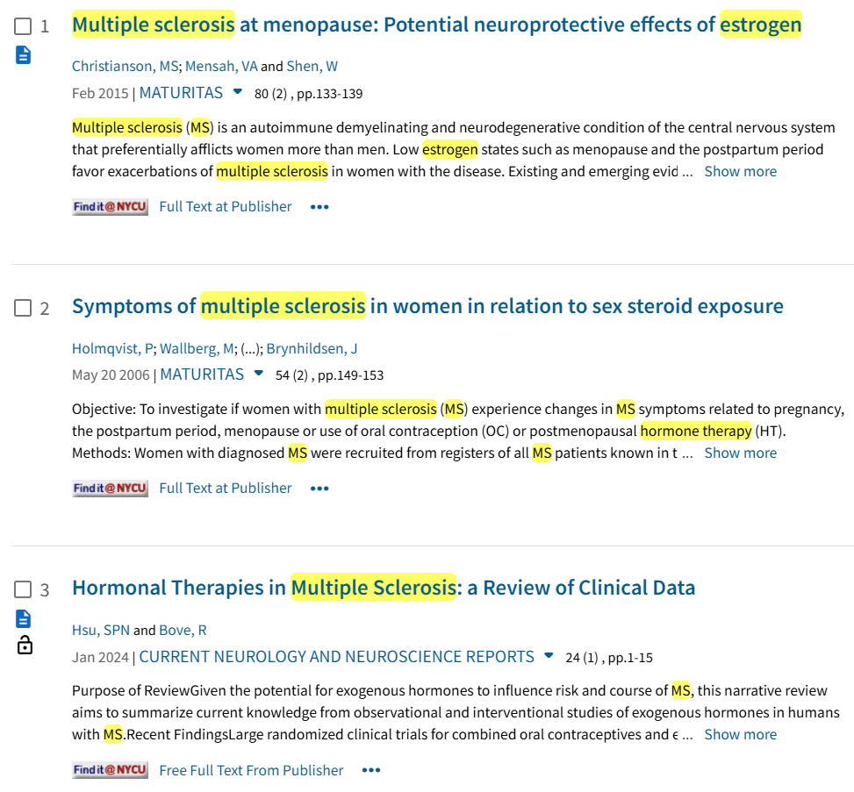
Web of Science

Slide 13
Scopus

Slide 14
Timeline
Optimize search strategy
Finalize protocol on Dec 25
Register PROSPERO on Dec 25th
26th and 27th Find duplicates
Start Screening articles on 28th Dec and finish by 10th Jan [screen articles by titles] (100 -150 /day ) Estimate 3800 articles
Start Screening articles by abstract on 11th Jan finish by 24th Jan ( 10-20 /day) est 400
Full text review start by 25th Jan and finish by 7th Feb

